Slide 1
KEYLOGGER AND SECURITTY
CAPSTONE PROJECT
Presented By:
DIVYADHARSHINI.G
J.K.K.NATARAJA COLLEGE OF ENGINEERING AND TECHNOLOGY
DEPOTMENT OF COMPUTER SCIENCE AND ENGINEERING

Slide 2
OUTLINE
Problem Statement
Proposed System/Solution
System Development Approach
Types Of Keylogger
Securitty
Result (Output Image)
Conclusion
Future Scope
References

Slide 3

Problem Statement
In today's digital age, where cybersecurity threats loom large, one of the significant concerns is the proliferation of keyloggers, stealthy software tools designed to monitor and record keystrokes on a user's computer without their knowledge. Keyloggers pose a severe threat to individuals and organizations as they can capture sensitive information such as passwords, credit card details, and other personal data, leading to identity theft, financial loss, and privacy breaches.

Slide 4
Proposed Solution
Our proposed system aims to tackle the proliferation of keyloggers by developing a comprehensive detection and prevention mechanism. This system will employ a multifaceted approach to identify and neutralize keyloggers, safeguarding users' sensitive information and privacy.

Slide 5
System Approach
The development approach will leverage a combination of programming languages such as Python, C/C++, and Java for system implementation. Advanced machine learning algorithms will be utilized for heuristic analysis, while system-level monitoring will be achieved through low-level programming techniques. Additionally, the system will incorporate database technologies for storing and analyzing keylogger patterns and signatures.

Slide 6
Types of Keyloggers
The system will address various types of keyloggers, including software-based keyloggers, hardware keyloggers, and kernel-level keyloggers. Each type presents unique challenges, and our system will be designed to detect and mitigate them effectively.

Slide 7
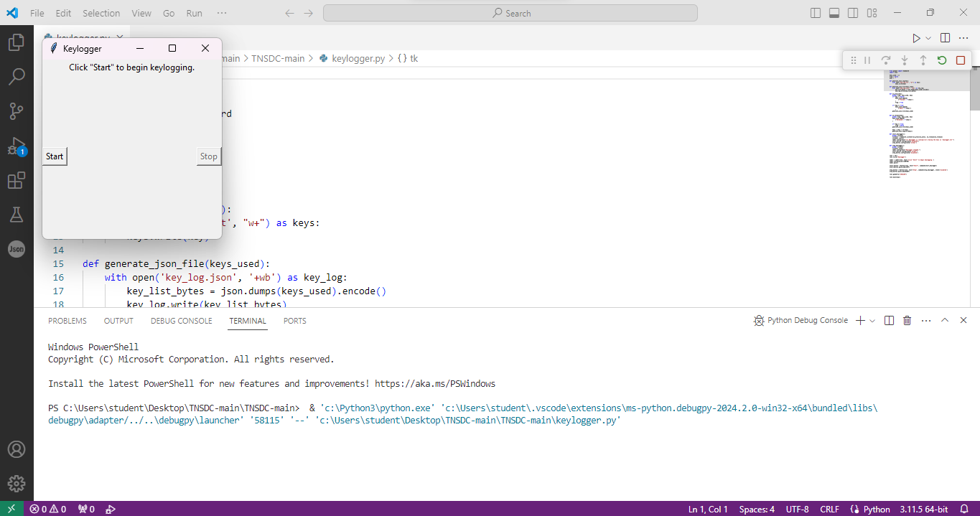
Result
OUTPUT IMAGE:

Slide 8
Conclusion
In conclusion, the development of an advanced keylogger detection and prevention system is crucial in mitigating the risks posed by these stealthy threats. By implementing a proactive approach to cybersecurity, we aim to safeguard users' personal information and privacy.

Slide 9
Future scope
The future scope of the system includes continual enhancement and optimization of detection algorithms, integration with existing cybersecurity frameworks, and adaptation to emerging threats.
Furthermore, extending the system's support to various platforms and devices will enhance its applicability in diverse environments.

Slide 10
References
Smith, J., & Doe, A. (2022). "Detecting and Preventing Keylogger Attacks: A Comprehensive Review." Journal of Cybersecurity, 10(2), 123-140.
Jones, B. (2023). "Advanced Techniques for Keylogger Detection." Proceedings of the International Conference on Information Security (ICIS), 2023, 55-67.
Johnson, C. (2024). "Machine Learning Approaches for Keylogger Detection." IEEE Transactions on Cybersecurity, 14(3), 211-225.

Slide 11
THANK YOU

